Slide 1
Plato Dr. Stephanie Spoto sspoto@mpc.edu Monterey Peninsula College
Gentrain
17 October 2018

Slide 2
Timeline of Ancient Greek Philosophy

Slide 3
Timeline of Ancient Greek Philosophy

Slide 4
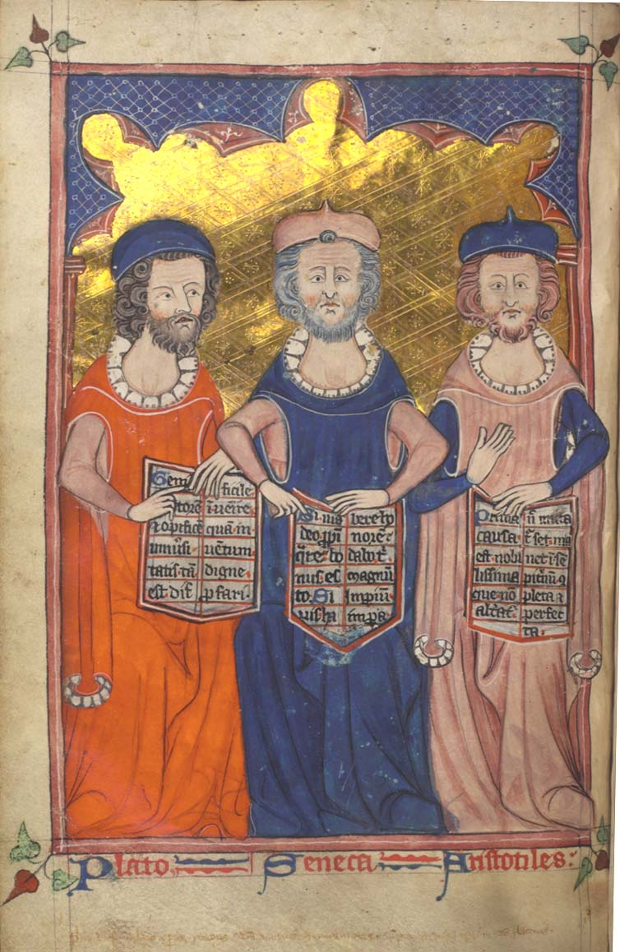
The importance of Plato
Plato and Aristotle most influential of all philosophers
Plato had a great effect Christian theology and philosophy until 13th century
Aristotle was the product of Plato, though his philosophy differed greatly
Born 428 BCE to aristocratic family
Plato, Seneca, and Aristotle from Devotional and Philosophical Writings, c. 1330

Slide 5
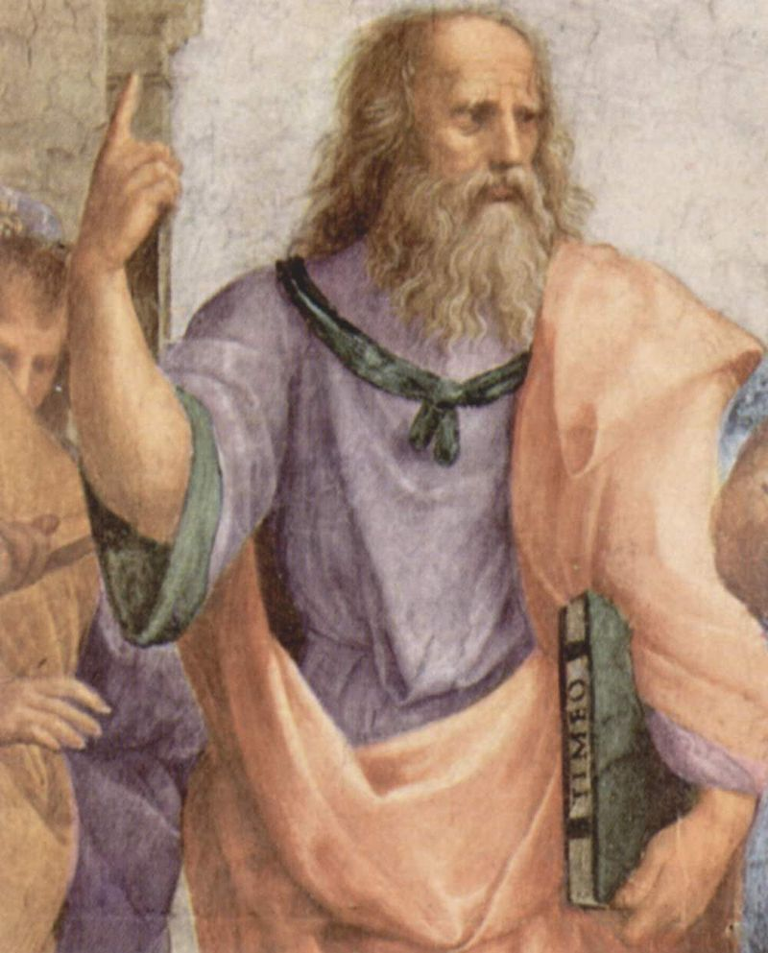
Plato’s Thought
Utopia, influenced a genre of philosophical writing
Theory of ideas, a new kind of wrestling with the problem of universals
Immortality, mystical → argument for the immortal soul
Cosmogony, the world as living creature with soul
Theory of knowledge, reminiscent rather than from perception
Plato is depicted in Raphael's The School of Athens anachronistically carrying a bound copy of Timaeus. c 1509

Slide 6
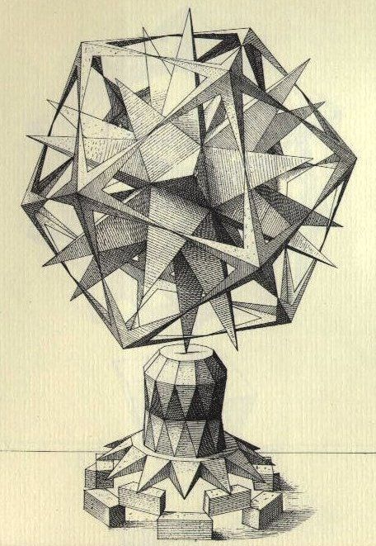
Influences
Pythagoras: Orphic elements of philosophy
Religious trend, immortality, priestly tone, other-worldliness
Respect for mathematics
Mingling of intellect and mysticism
Parmenides (Eleatic): Reality as eternal, timeless → change is illusion
Heraclitus: Nothing permanent in the sensible world
Combined with Parmenides’s philosophy, led Plato to belief that knowledge comes from the intellect and not the senses.
Socrates: Concern with the “good” and ethics
Most of the pre-Socratic schools less interested in “The Good” → Plato’s interest in this come Socrates
A drawing of an imaginary sculpture by Renaissance artist Wenzel Jamnitzer. 1568.

Slide 7
Skeptical of democracy
Aristocratic → associated with the rule of the Thirty Tyrants (pro-Spartan oligarchy installed in Athens after 404 BCE)
Reigned for eight months, killed 5% of the Athenian population, exiled democratic supporters, confiscated property
Lived through Athens defeat by Sparta
His teacher, Socrates, was killed by democratic government
Turns to Sparta for a model of his ideal commonwealth

Slide 8
Bertrand Russell’s theory of Plato’s authoritarianism
Goodness/Reality as timeless → states should copy heavenly models, i.e. static perfection and minimum change
Rulers those who best understand this eternal Good
Similar to other mystics, a center certainty inexpressible expect by way of life
Pythagoreans: desired to set up the rule of the initiated, which influenced Plato’s own views of proper political hierarchies → Statesmen must understand ‘the Good’, and can only know it through strict moral and intellectual discipline (the absence of this will lead to corruption)
According to Plato, being a good ruler required extensive education, including in geometry and mathematics.
Influenced by Pythagoras: without mathematics, no true wisdom is possible. Russell claims that this implies an oligarchy.
Leisure essential to wisdom → wisdom not found among those who must work for their living
Must be relieved from the burden and anxieties of making a living. An essentially aristocratic view

Slide 9
Plato’s five regimes of government Republic, Book VIII
Timocracy: People who love honor; arises from the aristocracy after civil war between aristocracy and the majority
Non-aristocratic birthrates will outnumber aristocratic, and will degrade concern with knowledge, music, “guardian education” towards acquiring possession and money
Civil war will erupt between those who value wisdom and those who value money until a compromise is reached
Oligarchy: emerges from confusion between wealth and honor → want to acquire wealth by any means
Injustice divides rich and poor so much that the rulers cannot wage war because arming the poor would be too risky
Democracy: When the poor overthrow the wealthy → create varied collections of people under ‘supermarket’ of constitutions
Demagogue who seems appealing is lifted up with support of the lower classes, but grants too much freedoms → ruler works to satisfy base pleasures
Tyranny: Demagogue turned tyrant → the lower classes invest more and more power into the demagogue in an attempt to maintain their liberties, and the demagogue becomes corrupted by the power → takes absolute control over his people

Slide 10
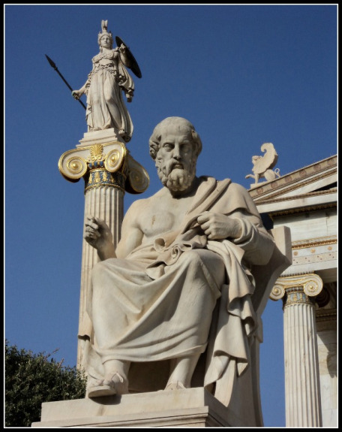
Wisdom as model for political power
Two questions emerge from these issues:
Is there such a thing as ‘wisdom’?
Can a constitution be constructed to give it political power?

